Slide 1
Forecasting Quarterly Revenue Using Macro-Economic Indicators
Jeff M. Paul
Colorado State University Global
MIS581: Capstone Project – Business Intelligence and Data Analytics
Dr. Kimberly A. Ford
11/01/20
Notes:
Good afternoon and welcome to today’s presentation entitled “Forecasting Quarterly Revenue Using Macro-Economic Indicators”.
My name is Jeff Paul and I will be leading you through the findings of this project.

Slide 2
A Tale of Two Sisters
Titanic
Britannic
Transatlantic Luxury Steamship
Legendary name
Catastrophic loss
Disregarded the forecast
Transatlantic Luxury Steamship
Relatively unknown
Saved thousands of lives
Acted upon the forecast
Notes:
We’re going to begin with a true story about two sisters…actually two sister ships. One that you’ve heard of, the other most likely not. Both impacted the world greatly, but in entirely different ways.
The names of these sisters - the Titanic and the Britannic.
These sister ships were extremely large transatlantic vessels belonging to the White Star Line
The Titanic is legendary (due to the epic failures that occurred) while the Britannic is relatively unknown.
One involved a catastrophic loss of life…while the other added life - by being converted into a hospital ship that served during WWI.
The difference between the two is that BOTH were provided forecasting abilities – but only one used the information. The Titanic was forewarned about the dangerous conditions ahead…but disregarded the evidence.
In the slides ahead, we’re going to learn about a tool that can forecast our revenues in the upcoming quarters. Knowing this information in advance, can help us make critical decisions today that may decide whether we keep our clients, investors and employees tomorrow.
At the end of this presentation, we’ll be presented with a choice - will we use it…or will we disregard the data and potentially suffer a fate similar to the Titanic?

Slide 3
Critical Issues facing First American
1. Limited resources
Time
Personnel
Equipment & Capital
2. Agility
18,000+ employees (worldwide)
How quickly can the organization react to opportunities in the market?
Key takeaways:
Difficult resource decisions must be made everyday
First American needs as much lead time as possible to make these decisions.
Notes:
There are two critical issues facing First American:
The first is limited resources. We simply do not have enough time, personnel, equipment and capital to achieve every profitable initiative on our list. This forces us to make tough decisions regarding what initiatives are approved and those that are side-lined.
The second critical area is the agility of the business. As of 2019, over 18K employees were actively employed and these employees are located throughout the world. With this number of personnel, a key question to ask is how quickly can be we react to opportunities in the market?
If First American was a vessel, it would be similar in size to the sister ships we just discussed…and these ocean liners are not known to be agile. They need plenty of time and space to execute a maneuver.
So we’re in a difficult spot. A question that some of you may be asking is where can we gain insight to overcome these issues? The answer can be found by observing other large organizations to see how they respond.
Let’s take a look at some of these organizations and their methods.

Slide 4
Research
Entities facing similar issues
Federal & State Governments
Policymakers
Large organizations
Macro-economic indicators
Focus on the overall economy
Pertain to specific attributes of the economy
Provide the overall health
Examples – Gross National Product, Housing Starts, Industrial Production
Regularly analyze these indicators, obtain insight and take action today to meet the demands of tomorrow (Joseph et al. 2014).
Notes:
When conducting research on this topic, we didn’t have to look too far before we identified other groups that faced similar issues.
For example, the Federal & State Governments and other large organizations are in the same challenging position as First American. We are all struggling with limited resources and having large numbers of people to manage.
So, what do they do to overcome these issues?
One critical approach they take is analyzing Macro-economic indicators.
Generally speaking, macro-economic indicators:
Focus on the overall economy
Pertain to specific attributes of the economy
Provide insight into the overall health
A few examples – Gross National Product, Housing Starts and Industrial Production
By analyzing leading macro-economic indicators, these organizations obtain critical insights into the health of the economy and their operations. This enables them to take action today that will enable them to meet the demands of tomorrow.
So let’s take a look at a few ways this indicators are being utilized.

Slide 5
Research – Literature Review
How are macro-economic indicators being used?
3-Month Treasury Bill index is used to predict U.S. Retail Sales (Joseph & Larrain, 2012)
U.S. Housing Starts data is effectively forecasting U.S. Vehicle Sales (Homareau, 2015)
3-Month Treasury Bill index and Interest Rates Spread enabled several researchers to identify the pending financial crisis of 2007-2009 (Joseph et al., 2014)
Companies within emerging markets are formulating their sales and marketing strategies (Adeola, 2016)
Notes:
The literature review on this topic provided numerous example of how macro-economic indicators are being used.
For example,
The 3-Month Treasury bill index has been identified as an accurate tool to use to predict U.S. Retail Sales (Joseph & Larrain, 2012). You can expect that Target, Walmart and other retailers are monitoring this indicator closely.
U.S. Housing Starts data is a macro-economic indicator that used to accurately forecast U.S. Vehicle Sales. Think of the automakers – GM, Ford, Hyundai and Mercedes.
Although many experts failed to predict the financial crisis of 2007 – 2009, there were researchers that accurately predicted this event by using macro-economic data. Using 3-Month Treasury Bill and Interest Rates Spread data, analysts predicted that a very difficult economic climate was approaching (Joseph et al., 2014). The success of their methods has led other researchers to use macro-economic indicators to forecast other areas in business (Joseph et al., 2014).
Finally, Macro-economic data has also been used towards predicting sales results at an organizational level. Companies, especially those operating within emerging economies, are particularly susceptible to the fluctuations of the macro-economic forces (Adeola, 2016). For them to succeed, they must closely track the macro-economic data and adjust their sales and marketing plans accordingly (Adeola, 2016).
These are just a few of the many examples on how organizations are utilizing these economic indicators to gain insight into the health of the economy. By understanding the business prospects ahead, organizations can implement the preparations necessary to maximize their response.

Slide 6
Business Question and Goal
Can First American forecast quarterly revenues using macro-economic data?
Goal – build an accurate forecasting model and use it to guide decisions regarding allocation of resources and in other areas
Effect – increase profitability, customer satisfaction, quality, employee satisfaction and market share.
Notes:
This background leads us to our project focus:
Since we’ve seen that macro-economic indicators are being used to forecast demand and to help guide their decisions, we need to ask a question.
If other organizations are using these indicators, can First American do the same?
For example, if First American can accurately predict their revenue in the upcoming quarters, they can determine if they have the right amount of resources to meet the expected demand. If revenues are expected to surge, the company can take appropriate action today to ensure this added volume can be processed effectively.
Before moving forward, it is critical to ensure that we are working with reliable data sources. Is this data being conjured up by some lone-wolf researcher locked up in his basement? Or are we working with credible data? Let’s take a look to ensure we build from a solid foundation.

Slide 7
Hypothesis
Null hypothesis (H₀) - the regression coefficients between the dependent variable (quarterly revenue) and each of the independent macro-economic variables are equal to zero.
H₀: Β₁=0, B₂=0,…,Bᵢ=0.
Alternate hypothesis (H₁) - the regression coefficients between the dependent variable (quarterly revenue) and each of the independent macro-economic variables are not equal to zero.
H₁: Β₁≠0, B₂≠0,…,Bᵢ≠0.
Notes:
The research performed to this point leads us to develop our Hypothesis.
We start off with the null hypothesis – which states that quarterly revenue CANNOT be forecasted using macro-economic indicators.
The exact opposite of this is our alternate hypothesis, which states that quarterly revenue can be forecasted using these indicators.
Before any statistical tests are performed, our assumption is that the indicators do not work. Therefore, the burden of proof is on our shoulders to show otherwise. To overcome this assumption, the test results must be so unexpected that they only would only occur less than 5% of the time.
Spoiler alert – the results that were found happened less than that 5% of time.
The To understand the approach taken within this study and why it is so important - it will may be helpful to first take a quick look at our judicial system.
In a court room, the defendant has certain rights that are protected by the law. One of the most important of these is that, regardless of the crime, they have the protection of being assumed innocent until proven guilty. The prosecution must build a case, using facts and observations that must demonstrate beyond a reasonable doubt that the individual is actually guilty. If they cannot, the defendant is cleared of all charges.
Now, in this data analytics project, the exact opposite approach is taken. We start off by with the assumption that macro-economic indicators CANNOT predict quarterly revenue.
To reject this assumption…to conclude that these indicators can predict quarterly income…the statistical results, the evidence, must be so unexpected that they only occur less than 5% of the time.
Data – rigorously examined for features such as abnormalities, missing and/or wrong values.
During the Correlation testing – our goal was to prove that there is a relationship between the indicators and quarterly revenue
Finally, we engaged in a regression analysis – which enabled us to develop a model using Personal consumption and First American’s quarterly revenue.
Before we share the results, lets first take a look at a couple of graphs that represent First American’s quarterly revenue.
Backup info (if needed):
We found a strongest relationship between the macro-economic indicator Personal Consumption and First American’s quarterly revenue. In fact, since moderate-to-strong associations were found between Personal Consumption and the other indicators, we had to remove all the other indicators in this study. If they were kept in, the results would have been negatively affected.
Why regression testing? Continuous data, normally distributed, linear relationship between the variables
.

Slide 8
Objectives
Collect U.S. macro-economic data and quarterly revenue data
Determine the distribution of each independent and dependent variable
Transform variable(s) that have failed the normality test
Determine correlations between the variables
Develop a regression model to predict quarterly revenue
Notes:
With our hypothesis in mind, we need to map out our objectives. They are:
Collect U.S. macro-economic data and quarterly revenue data
Determine the distribution of each independent and dependent variable
Perform transformations on any variable(s) that have failed the normality test
Determine correlations between the variables
Develop a regression model to predict quarterly revenue
This process begins with our ability to collect reliable data.
Let’s take a look at our data sources.
To develop a regression model between the macro-economic variable(s) and the quarterly revenue such that the p-value of the F-test is lower than an alpha of .05 and the model demonstrates an R² value greater than .70.

Slide 9
Data Sources
1. Federal Reserve Bank of St. Louis (FRED Economic Research, 2020)
Gross National Product
Housing Starts
3-Month Treasury Bill Index
Hundreds of other indicators
2. U.S. Securities and Exchange Commission (U.S. Securities and Exchange Commission, 2020)
Quarterly revenue of FAF
Notes:
Fortunately, there are two primary data sources that we can use.
The first is from the Federal Reserve Bank of St. Louis, while the second is from the U.S. Securities and Exchange Commission.
Within the Federal Reserve, macro-economic indicators such as the GNP, Housing Starts, 3 Month Treasury Bill Index and hundreds of other indicators are being tracked.
Within the SEC are the annual reports, quarterly reports and others required reporting submitted companies to satisfy the requirements of the Securities and Exchange Commission.
As these sites contain official Reports from the Federal Reserve Bank of St. Louis AND the U.S. Securities and Exchange Commission, I think we would agree that it would be a challenge to come up with a stronger data set.
With the data obtained, we can begin looking at some of the results. We’ll start off by looking at Quarterly revenue..

Slide 10
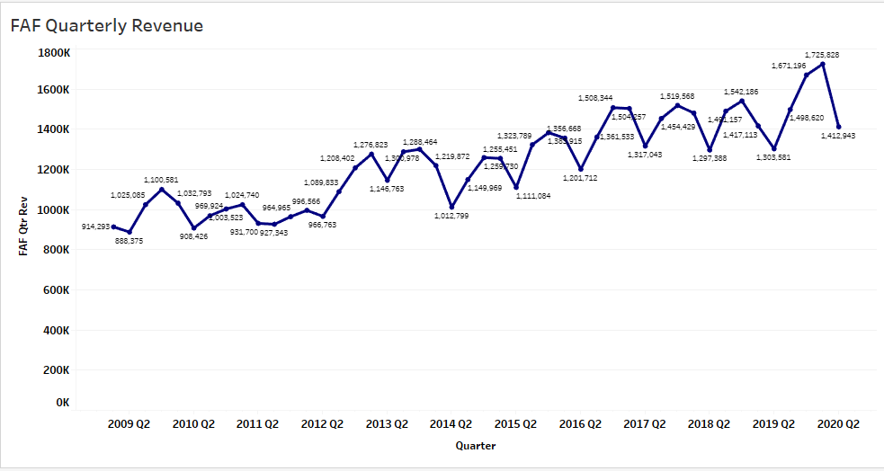
Quarterly Revenue - Trendline
Notes:
Here’s an overview of FAF quarterly revenues since 2009.
As seen in this chart, the first quarterly revenue was approximately $925,000 and it eventually peaked at $1.725 million in 2020 (U.S. Securities and Exchange Commission, 2020) . Interestingly, the average quarterly revenue was relatively flat from 2009 until the second quarter of 2012. After this time, the quarterly revenue began to trend higher.

Slide 11
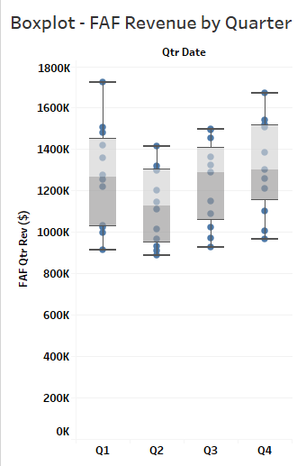
Quarterly Box Plot Analysis
Box plot benefits:
Side by side comparison of quarterly revenues
Displays the range in revenues within each quarter
Areas within the box demonstrate where quarterly revenues occurred 50% of time
Notes:
A second way to understand First American’s quarterly revenue is through the use of a Box plot.
In the chart, the quarterly revenue results for each quarter are displayed.
You can easily see the maximum and minimum values for each quarter.
The box within each line illustrates where 50% of the revenues have occurred.
Finally, it allows a side-by-side comparison of the revenues between each quarter.

Slide 12
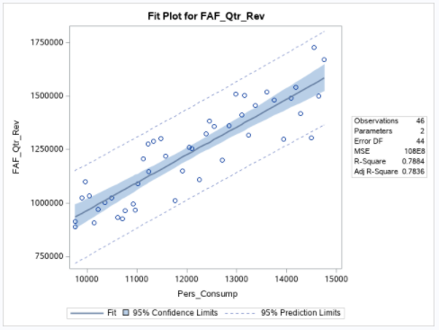
Quarterly Revenue – Personal Consumption
Notes:
So here’s the illustration of the regression model that was created and the actual results since 2009.
This chart demonstrates the relationship between First American quarterly revenue and Personal Consumption.
You can see that as Personal Consumption increases, First American quarterly revenue tends to rise with it. These two figures move in tandem 89% of the time.
The solid line represents the predictive model’s estimate of quarterly revenue for each Personal consumption value.
The dotted lines – 95% confidence of where quarterly revenue is expected at each Personal Consumption level. It essentially states the Lower bound and upper bound.
Example if Personal Consumption is forecasted to be $12 Trillion, then FAF quarterly revenue is expected to be between ($1B and $1.45B).
To see the equation that generated this information, let’s go to the next slide.
Background info (share only if needed)
Variation is normal. Line is the amount least amount of errors.
After the correlation analysis were completed, we found that results for Personal Consumption and First American quarterly revenue move in tandem 89% of the time. If personal consumption goes up, FAF quarterly revenue can be expected to go up…and when personal consumption goes down, FAF quarterly revenue can be expected to go down.
Blue shaded area is 95% confidence level of the line equation

Slide 13
Quarterly Revenue Prediction
FAF Quarterly Revenue = -303,638 + (127.532) * Personal Consumption
Strength – 79.54%
80% of FAF quarterly revenue can be explained by this model.
Notes:
To predict quarterly revenue is fairly simple, just plug in the estimated Personal Consumption figure, multiply that by 127.532 and then subtract -303,638.
The beauty is in its simplicity and strength. When tested, this equation explains approximately 80% FAF Quarterly revenue.
To bring this down to a personal level, let’s say you found your dream home but are significantly concerned on whether you can afford it. Having a method that can forecast 80% of your income next year, could be instrumental in your decision making. Especially when you the headlines are making contradictory predictions.

Slide 14
Revenue Model Benefits
Easily understood
Statistically supported
Use in conjunction with other forecasting models
Enhance resource allocation decisions
Increase profitability
Boost customer satisfaction
Improve employee satisfaction
Enhance quality
Increase market share
Notes:
Knowing this information, what are the benefits?
First – it’s easily understood.
Second – it is statistically supported. Based on evidence instead of hear-say.
Third – it can be used in conjunction with other forecasting tools. As relying on one method can be risky, you can now verify the data with another independent source.
Finally, and most importantly, it can enhance our resource allocation decisions. We have a way to determine what resources we’ll need ahead of time.
For example, let’s say that current staffing levels are able to produce $1B worth of products & services. If our model estimates that we’re expecting $2B worth of revenue, then we’ll either need to double our staff to meet this demand…or risk losing out of $1B worth of revenue. As a shareholder, I would have some serious questions to ask about losing out on revenue opportunities…or by carrying excessive overhead when businesses slow down.
By effectively balancing our resources with projected revenues, we can:
Increase profitability – maximize the investment in our resources
Boost Customer satisfaction – by avoiding delays and/or turning away their work
Improve Employee satisfaction – ensuring fair and balanced workloads
Enhance Quality – not cutting corners to meet customer requirements
Increase market share – attracting clients due to stable production

Slide 15
Recap
Government agencies & individual companies utilize macro-economic indicators to forecast business environment
Can these indicators also benefit First American?
Utilized reliable data sets from Federal Reserve and the SEC
Discovered a strong association between Personal Consumption and Quarterly Revenues
Created Regression model to forecast - 80% explanation.
Notes:
So here’s a quick recap of what we’ve learned:
First American faces the critical issues operating with limited resources and in responding in an agile manner.
We found that Government agencies & individual companies utilize macro-economic indicators to forecast business environment
We’ve researched the business question - can these indicators also benefit First American?
By utilizing reliable data sets from Federal Reserve and SEC, uncovered a strong association between the indicator Personal Consumption and First American’s Quarterly Revenues we’ve created a predictive model to forecast revenues. This model can explain 80% of the future revenue.

Slide 16
Next Steps
Implement model
Closely track monthly Personal Consumption data
Triangulate results with other factors being used
Demonstrate results
Research other economic indicators and predictive tools such as time-series analysis.
Notes:
Before we wrap up our presentation, what are our next steps?
The first recommendation is to implement the model and begin tracking Personal Consumption on a monthly basis.
Second, use these results and compare them to other tools being used to forecast upcoming revenue.
Compare the results of this model against current tools.
Research other economic indicators and predictive tools that can further improve upon the model’s strength.
This completes our presentation and we’ll open floor to questions.
Thank you…

Slide 17
References
Adeola, O. (2016). The impact of macroeconomic conditions on sales performance in Nigeria. The Journal of Developing Areas. Retrieved from http://eds.a.ebscohost.com.csuglobal.idm.oclc.org/eds/pdfviewer/pdfviewer?vid=5&sid=3d5199e1-fb5c-4176-89f1-35c81dd403e5%40sessionmgr4008
FRED Economic Research. (2020). FRED economic data. FRED Economic Data | St. Louis Fed. Retrieved 10/10/20, from https://fred.stlouisfed.org/
Homareau, J. (2015). Forecasting sales volumes with economic indicators. Journal of Business Forecasting. Fall 2015, Vol. 34, Issue 3, pgs. 32-34. https://www-proquest-com.csuglobal.idm.oclc.org/docview/1770021221?accountid=38569

Slide 18
References continued
Joseph, A., & Larrain, M. (2012). Housing Starts forecast of Retail Sales through the 2007-2009 Recession. Procedia Computer Science. 2012. Vol. 12, pgs. 271-275. https://www-sciencedirect-com.csuglobal.idm.oclc.org/science/article/pii/S187705091200659X?via%3Dihub
Joseph, A., Larrain, M., & Turner, C. (2014). The Treasury Bill rate, the Great Recession, and Neural Networks estimates of Real Business Sales. Procedia Computer Science. 2014, Vol. 36, pgs. 227-233. http://eds.b.ebscohost.com.csuglobal.idm.oclc.org/eds/detail/detail?vid=6&sid=e5c68f15-8b9e-4e83-902b-15cec11e0a7c%40pdc-v-sessmgr03&bdata=JnNpdGU9ZWRzLWxpdmU%3d#AN=S1877050914013337&db=edselp
U.S. Securities and Exchange Commission. (2020). Edgar Company findings. U.S. Securities and Exchange Commission. Retrieved 10/10/20 from https://www.sec.gov/edgar/searchedgar/companysearch.html

